Slide 1
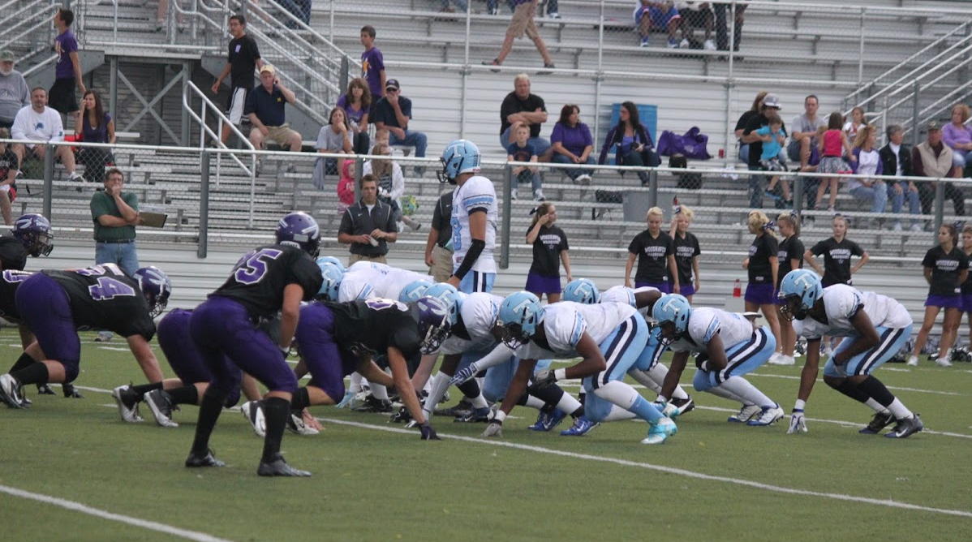
BUILDING THE TIGHT T OFFENSE
Eric Stiegel
Head Football Coach
Taylor Truman High School

Slide 2
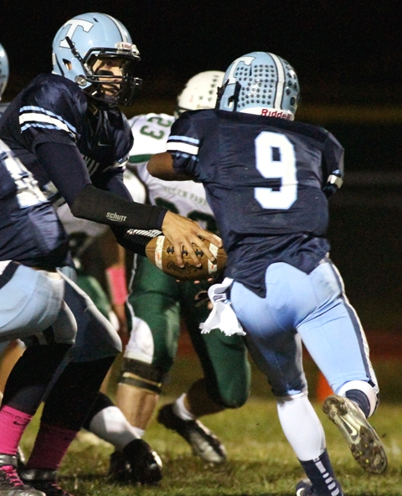
WHO WE ARE
Taylor Truman HS – Taylor, MI - 1100 kids (Downriver League)
No middle school program
Went from 1-8 to 9-2 (best record in city history) League Champs in 2012
Averaged 40 points and nearly 400 rush yards per game
Also led the DRL in scoring defense in 2012

Slide 3
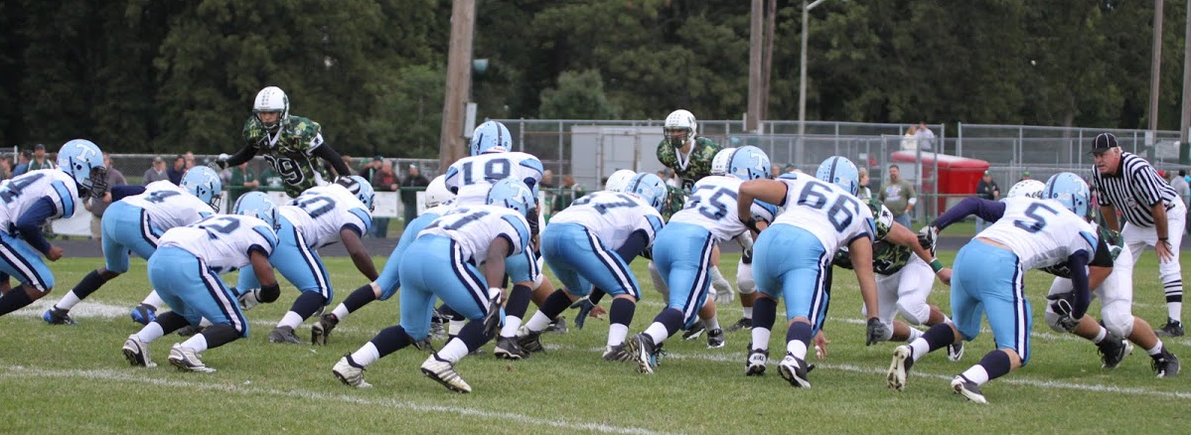
WING T?
Very vague and can mean different things to different people
We are wing T in that we have a series of plays that are in direct relation to each other - Trap, Power, Keep
We are not a traditional Wing T blocking team
We are not a strict rule blocking team
Most wing T believe in angle blocking and “down blocks”
We are a team that believes in vertical movement and drive blocks. With tight splits we think our best advantage is to drive block the DL off the ball.

Slide 4
BE GREAT AT SOMETHING
Techniques matter
How many do you feel comfortable asking your players to perform at a high level?
When it is 3rd and 2 we believe that we can execute a technique that we have practiced 1000’s of times.
We need limits
I have been a coach in different offenses.
Coaches have a lot to worry about; Motions, shifts, formations, personnel groups ect.
We were in the T 100% this year, we were not in the past.
Make adjustments to run our base plays.
I feel that we can ask our kids to do anything scheme wise as long as we are asking them to use a technique they are great at.

Slide 5
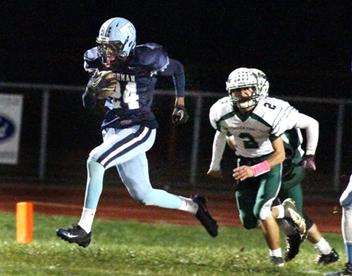
NON-CONVENTIONAL
We practice what we do every day from August to November; you practice on stopping it for 2 days.
It forces many teams to get out of their base defense
It puts players and coaches out of their comfort zone
Think of where a corner usually plays and what he looks for
Think of what goes through the DL head

Slide 6
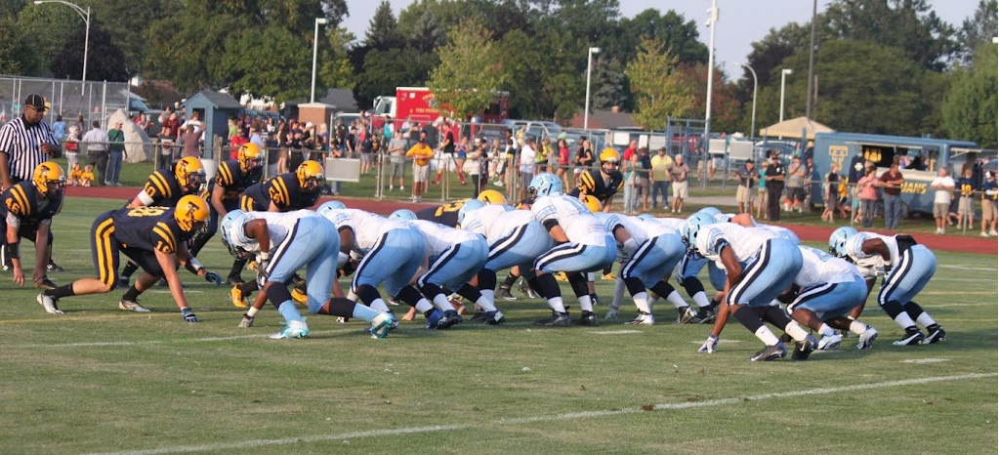
THE TIGHT T IS A SPEED OFFENSE
Most people view the T as a slug it out offense
We can slug it out, but….
I don’t believe there are many offenses that get your running backs in the hole faster.
In the I formation a TB aligns at around 7 yards. Our backs are 4.5 yards.
We are going to get there faster.
LB’s are not used to having to fit that quickly.

Slide 7
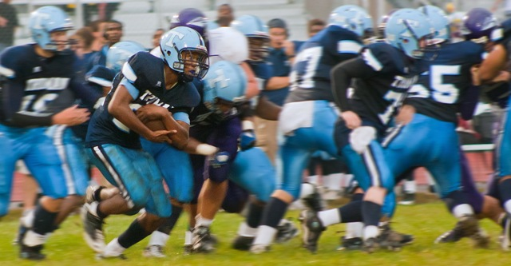
GREAT GOALINE OFFENSE
We do not have to change personnel, scheme, or philosophy when we get to the most important part of the field. We run what we do well and our whole playbook is accessible to us.

Slide 8
FITS MULTIPLE PERSONNEL
We do not require big offensive lineman
our guards were both under 170lbs this season
You don’t need a true QB or feature TB
we can fit our system to our QB’s talents and feature 3-4 different backs.
We rushed for nearly 4000 yards this season and did not have one back go over 1000 yards.
It builds a team
Our backs realize the importance of blocking and faking
Team success depends on all 11 players. Not just the guy with the ball.

Slide 9
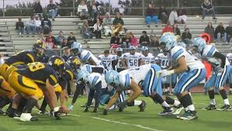
IT BUILDS A PHYSICAL DEFENSE
Practicing against a physical offense in August and throughout the year breeds toughness.
Our DB’s play running back and are inside runners and physical blockers
Our LB’s are RB and TE’s that play physical on offense

Slide 10
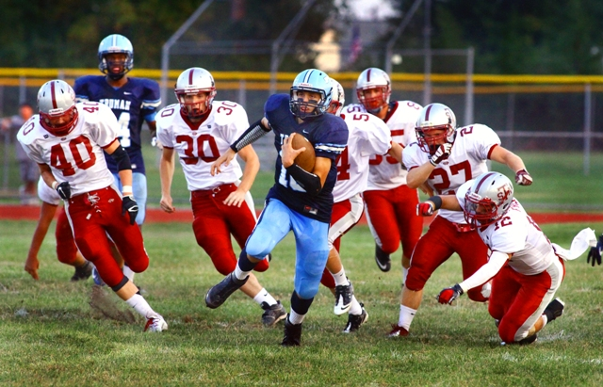
WHAT HAPPENS IF THE STOP US?
The same thing that happens to any offense that gets stopped, you lose.

Slide 11
BUILDING THE OFFFENSE
In the offseason we ask ourselves what type of offense are we going to be?
We look at personnel and try to focus on what they will be able to do well within the framework of who we are.
It starts with the QB.
This year we had a great running QB and we attempted only 35 passes in the regular season. The previous season we had more polished passer and through for 1000 yards out of the T.
We feel we must threaten the defense in some way with our QB. Hopefully we can do it both running and passing, but he must be able to do it at least one way.

Slide 12
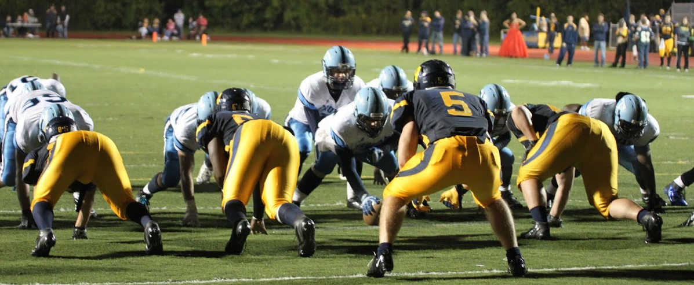
THE OFFENSIVE LINE
Our personnel on the O-Line does not have a giant impact on what we will run. We are looking at which pieces will fit well in spots.
Our most physical drive blockers must be our Tackles and TE (generally our bigger kids)
Our kids with a nasty attitude who can play in space are guards
Our center must be quick, but also sturdy

Slide 13
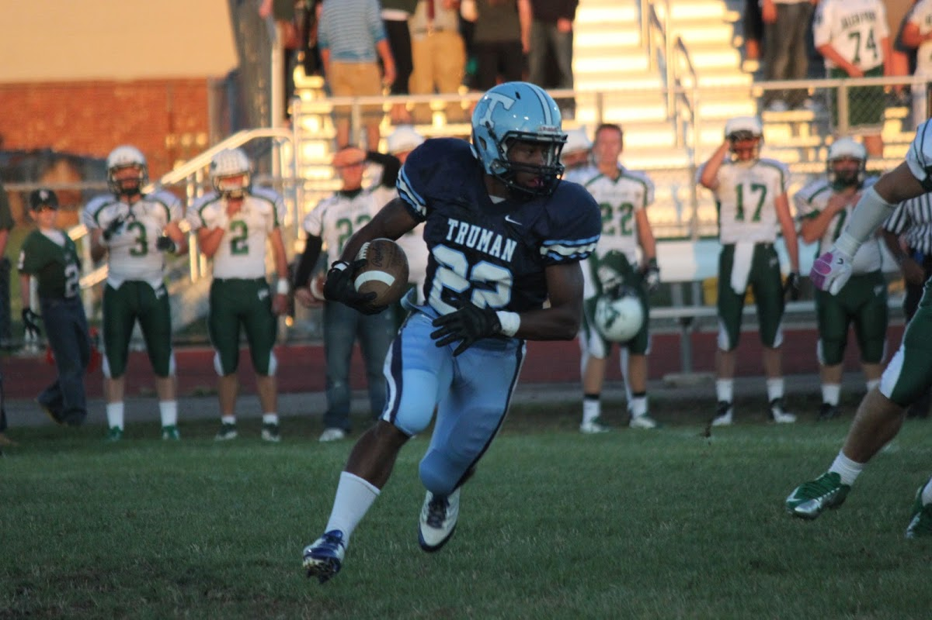
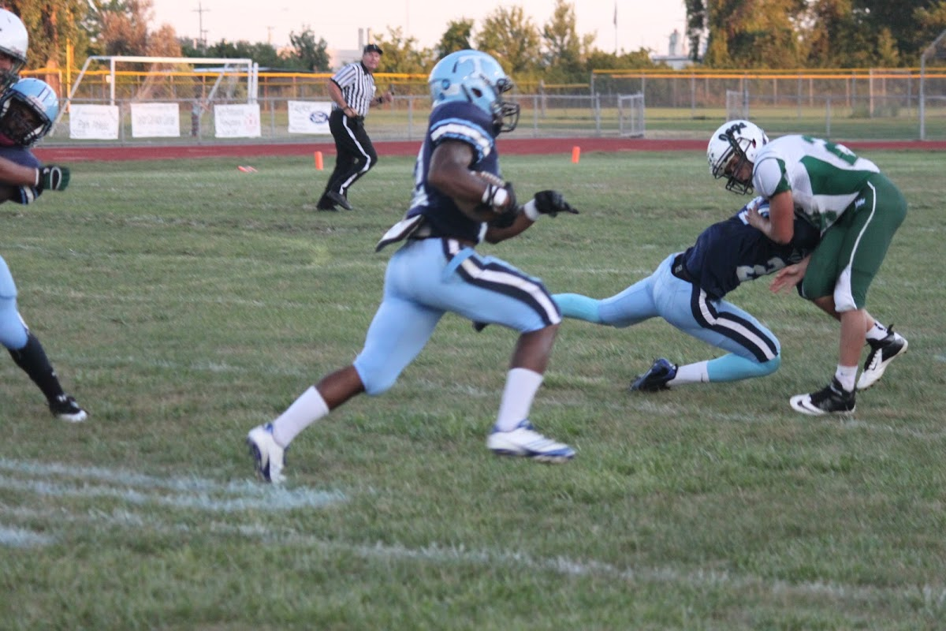
RUNNING BACKS
We generally like to put our most explosive playmaker at the 4 back (middle of the T). Many people call that position the FB. This player runs our inside/outside traps, toss plays, and iso plays (if installed)
The 2/3 backs must be our downhill physical runners. They have to be able to J block bigger kids and run the off tackle plays with authority. They are also the backs who are more likely to be featured in the pass game.

Slide 14
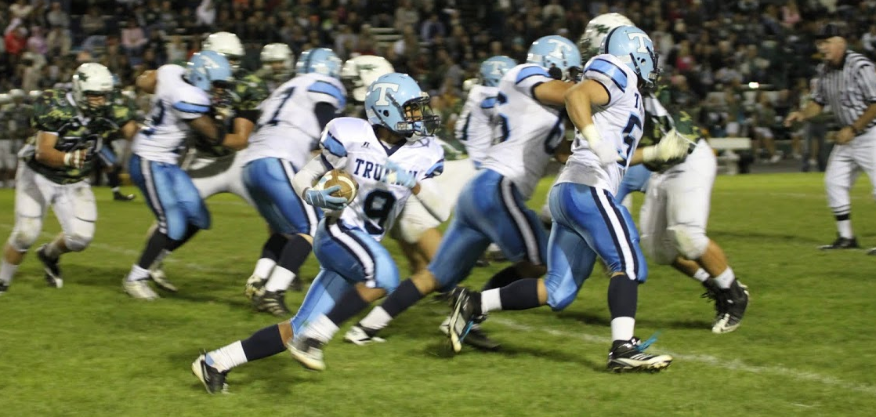
ELIMINATE SPACE FOR THE DEFENSE
Spread teams use formations to widen out a defense and many times use wide splits with their offensive line. We have all heard that phrase we want to spread out the defense and create space.
We are the opposite. We want to eliminate the space that you have to play in. We are usually in tight splits because it eliminates space for the d lineman.

Slide 15
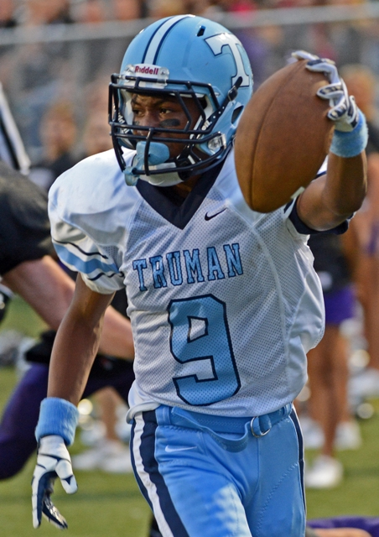
PUT DEFENDERS IN DIFFERENT SPOTS
We bring in the corners into a territory where they are not used to playing.
The opponents are in uncharted waters as they are asking DB’s to be more of a factor in the run game, but they still have to worry about play action and getting beat deep. This can be a bind for them.
Our kids play in the same space every down.

Slide 16
ATTACK THE WHOLE FIELD
We believe that to be successful on offense that we need to be able to run off tackle, run our trap game effectively, and be able to threaten the defense with the QB.
The QB is the guy who can stretch out a defense for us.
If he runs the keep play well he forces more defenders to play outside and he stretches the defense horizontally
If he throws the ball well he forces the DB’s to play more cautiously and he stretches the field vertically.
If he can do both we should have good numbers to run against in the box.

Slide 17
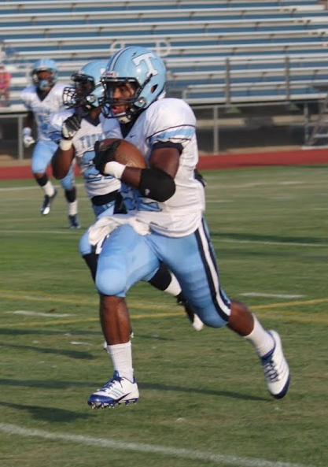
PRACTICE PLAN
2012 Day 1
INDY #1 15 Min
OL – Boards/Drive Blocks (Block the Shade to playside)
RB – J Blocks (great footwork, head inside, be thick, take a squeezer vertical) H blocks
QB – Throwing Circuit
Indy #2 15 Min
QB/RB - backfield action (proper footwork, faking with energy, force the QB to put the ball up into the half back even when faking after trap)
OL – 2nd Levels/Train
Group #1 (two 7 min periods)
1 QB/4back/HB/TE – Play action period
C/G/T 1 QB, 4 back – Trap drill vs. two fronts
Group #2 (two 7 min periods)
Alley Drill (1 Set Backs, C, G’s, TE’s) T hold Bags
Other Backs and TE are working routes
Team #1
Vs. Odd, Covered, Even (22)
40/41
26/37
56/57 Alley
18/19
42/43
48/49 Toss
18/19 pass
18/19 wheel
26/37 counter
37 boot solid
26 Michigan
18 TE Screen Left

Slide 18
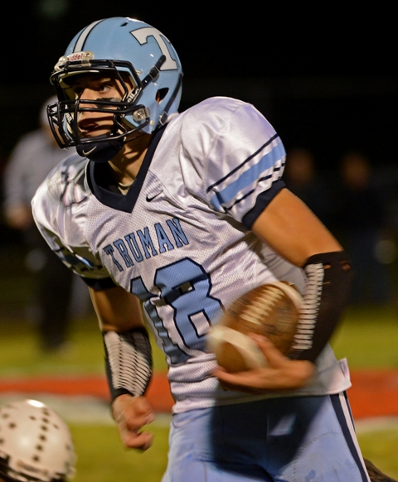
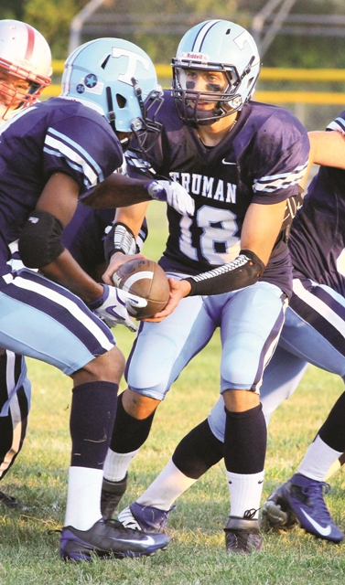
TIGHT T PASS GAME
Eric Stiegel
Head Football Coach
Taylor Truman High School

Slide 19
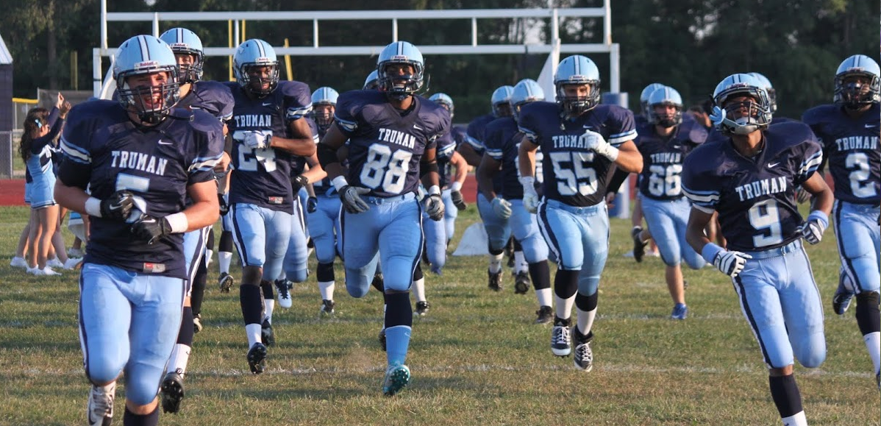
BASIC INFO
We throw the ball more than most Tight T teams.
This year we threw it about 40 times in the regular season.
Many were for big plays and long gains
In 2011 we threw for nearly 1000 yards
We are not going to be too stubborn

Slide 20
WHAT WE DO
About 90% of our pass game is play action.
10% is sprint out game
Just like any other team we try to scheme our routes and combinations towards specific coverage to attack different spots of the field.
Limited on screens

Slide 21
PROTECTION COMES FIRST
We want our pass protections to resemble the run game as much as possible
Don’t see much blitz or aggressive pass rush due to inside run game
We do have to account for a lot of defenders since we usually see a loaded box
We scheme our protections every week
Backside is key
Fakes can take time

